Slide 1
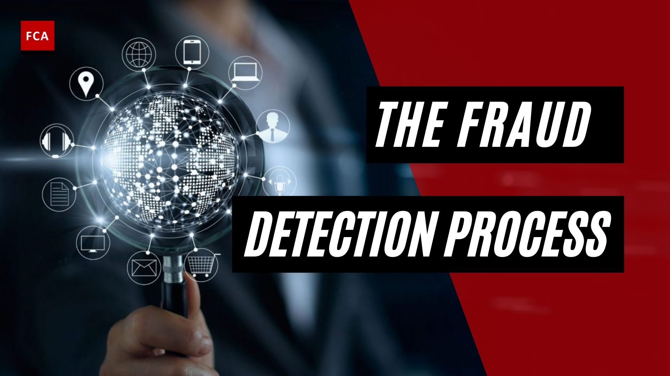
TRANSACTIONAL FRAUD DETECTION SYSTEMS

Slide 2
Table of Contents
1. Abstract
2. Introduction
3. Problem Statement
4. Technologies Used
5. Modules
6. Dataset
7. Data Flow Diagram
8. System Architecture
9. Model Evaluation
10. Screenshots
11. Advantages
12. Conclusion
13. References

Slide 3
Abstract
This project presents a comprehensive Transactional Credit Card Fraud Detection System designed using machine learning, SQL analytics, and interactive dashboards. The system analyzes historical transaction data to identify patterns of fraudulent activity and predicts suspicious transactions in real time.
The project addresses the challenge of detecting fraud within highly imbalanced datasets, where fraudulent transactions represent a very small percentage of total data. By integrating data engineering, machine learning, and visualization tools, the system not only predicts fraud but also provides actionable insights for business decision-making.

Slide 4
2. Introduction
With the increasing adoption of digital payment systems, financial fraud has become a major concern for organizations worldwide. Fraudulent transactions are often hidden within large volumes of legitimate transactions, making detection complex and challenging.
Traditional rule-based systems are no longer sufficient to handle evolving fraud patterns. Therefore, advanced analytical and machine learning techniques are required to identify anomalies and predict fraud effectively.
This project aims to build a scalable fraud detection system that combines data processing, predictive modeling, and real-time visualization to improve fraud detection accuracy and business efficiency.

Slide 5
3. Problem Statement
Financial fraud results in significant monetary losses and damages customer trust. The primary challenge is to identify fraudulent transactions that are rare and difficult to detect within large datasets.
3.1 Fraud Detection
Fraud detection involves identifying suspicious transactions that deviate from normal behavior. It requires analyzing transaction data, identifying anomalies, and applying predictive models.
3.2 Fraud Detection Process
Data collection from transaction records
Data cleaning and preprocessing
Exploratory Data Analysis (EDA)
Feature engineering
Model training and evaluation
Real-time fraud prediction

Slide 6
4. Technologies Used
The project leverages a combination of data engineering, machine learning, and visualization tools:
4.1 Machine Learning
Used classification models to detect fraudulent transactions. Implemented probability-based prediction. Applied threshold tuning for better performance on imbalanced data.
4.2 Python
Core programming language.
Libraries used:
Pandas (data manipulation)
NumPy (numerical operations)
Scikit-learn (model building)
4.3 PostgreSQL
Used for cleaning, storing and managing transaction data .
Enabled efficient querying and data analysis.
4.4 Streamlit
Built interactive web application. Enables real-time fraud prediction.
4.5 Power BI
Used for dashboard creation. Visualizes fraud patterns and insights.

Slide 7
5. Modules
The system is divided into the following modules:
5.1.Data Preparation and Initial Exploration
Cleans data, handles missing values, and prepares dataset
Using SQL to query and extract the transaction dataset, Performs 21+ queries for business insights.
Load the data into a Pandas DataFrame and perform initial profiling (check data types, missing values, basic statistics using .info() and .describe()).
Handle missing values and correct data inconsistencies.
Analyze the class imbalance (fraudulent vs. non-fraudulent transactions), which is critical for this problem.
5.2 Deep Dive with Exploratory Data Analysis (EDA)
Performing univariate and bivariate analysis. Analyze the distribution of key variables like transaction amount, time of day, etc., for both fraudulent and legitimate transactions.
Using visualizations (histograms, box plots, scatter plots) to compare the characteristics of fraudulent vs. non-fraudulent activities.
Identify key features that appear to be strong indicators of fraud. Document all initial findings in notebook.
5.3 Feature Engineering and Baseline Modeling
Create new features that improve model performance (transaction frequency for a user, time since last transaction).
Split the data into training and testing sets. Train a simple classification model, like Logistic Regression, to establish a baseline performance.
Evaluate the model using appropriate metrics for imbalanced data (Precision, Recall, F1-Score, ROC-AUC curve) instead of just accuracy.

Slide 8
5.4 Analysis, Reporting, and Dashboard Creation
Interpret the model's results and identify the top predictors of fraud.
A detailed report summarizing your methodology, EDA findings, and model performance.
Creating an interactive dashboard in Power BI that showcases key trends, patterns of fraud, and high-risk segments.
SQL Analytics Module Performs 21+ queries for business insights
Machine Learning Module Predicts fraud using trained model
Application Module (Streamlit) Provides user interface for real-time prediction
Visualization Module (Power BI) Displays trends and insights

Slide 9
6. Dataset
The dataset contains anonymized credit card transactions.
Features:
V1–V28 (PCA-transformed features)
Transaction Amount
Time
Target (Class: Fraud / Legitimate)
Key Characteristics:
Highly imbalanced dataset
Fraud transactions ≈ 0.17%
Requires special handling techniques
7. Data Flow Diagram
The system follows this pipeline:
Raw Data → Data Cleaning → PostgreSQL → SQL Analysis → ML Model → Streamlit → Power BI
Insight:
Ensures smooth data processing and real-time fraud detection.

Slide 10
8. System Architecture
User → Streamlit App → ML Model + SQL Queries → Database → Dashboard
Key Feature:
Combines prediction + analytics in one system
Supports real-time decision-making
9. Model Evaluation
9.1 Metrics Used
Precision
Recall
F1 Score
ROC-AUC
9.2 Confusion Matrix
True Positive (TP): Correct fraud detection
True Negative (TN): Correct normal detection
False Positive (FP): Wrong alert
False Negative (FN): Missed fraud
Key Insight: False Negatives are more critical than False Positives
9.3 ROC Curve
Measures model performance
Helps select optimal threshold

Slide 11
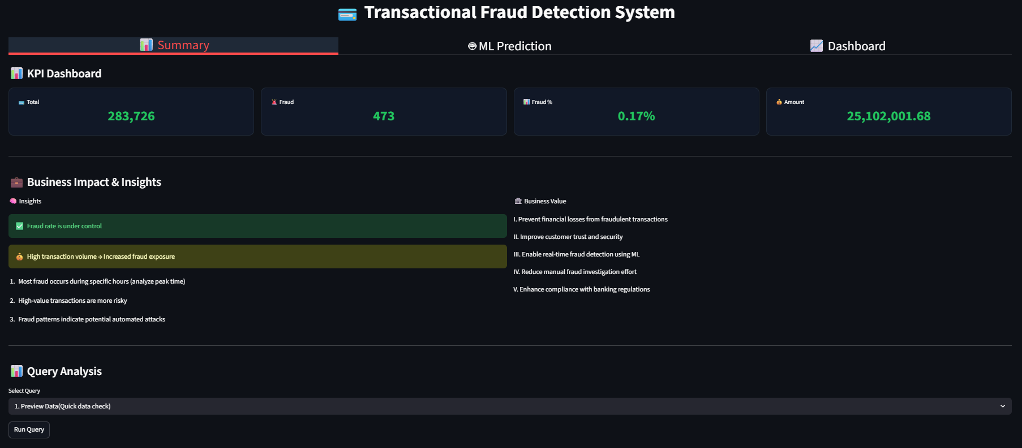
10. Screenshots
10.1 KPI Dashboard

Slide 12
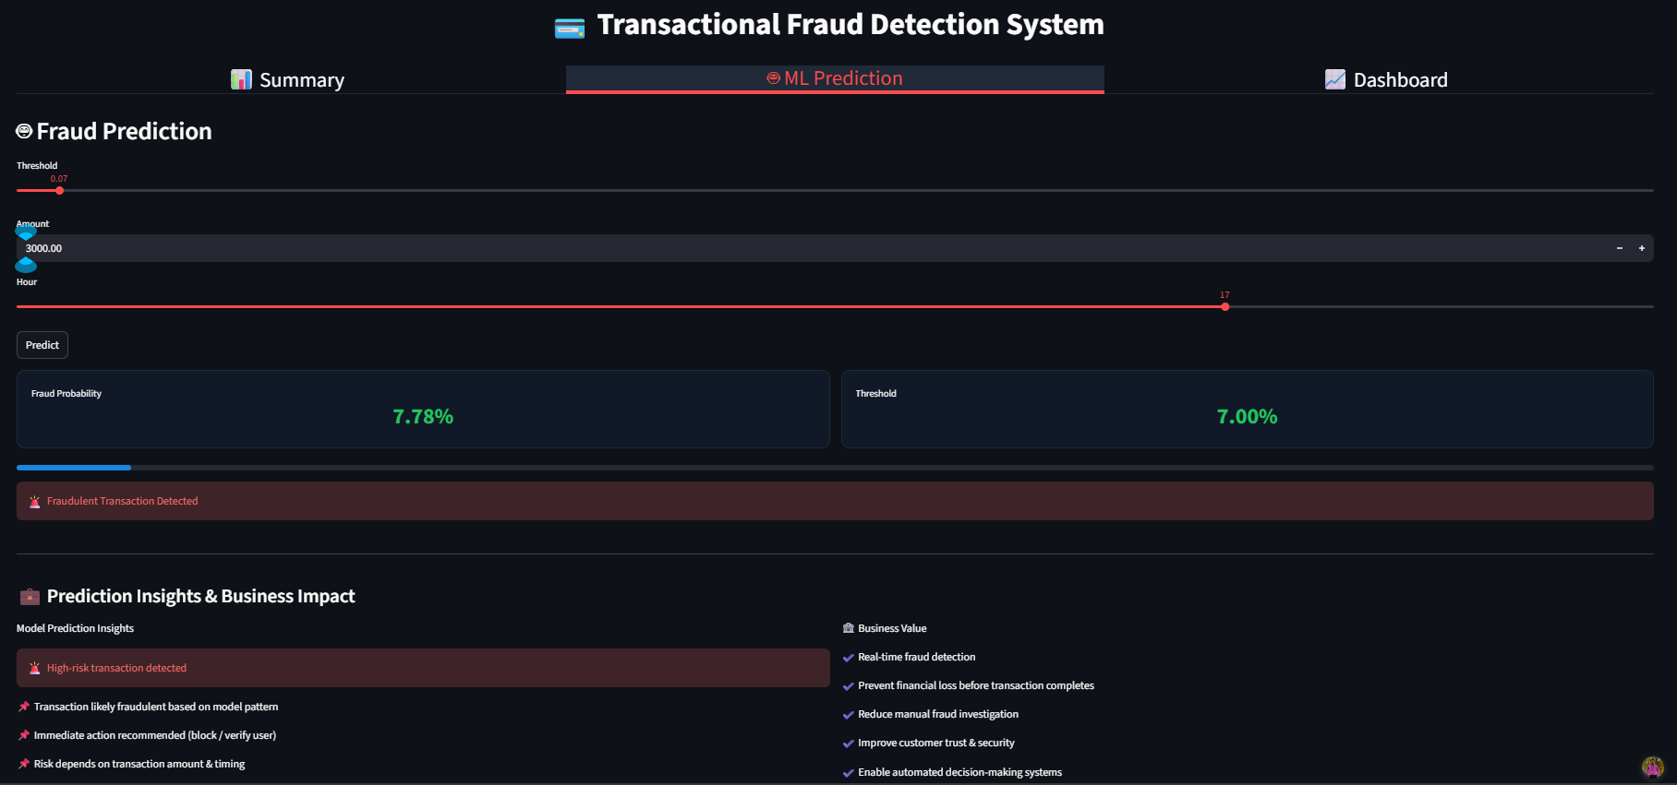
10.2 Prediction System

Slide 13
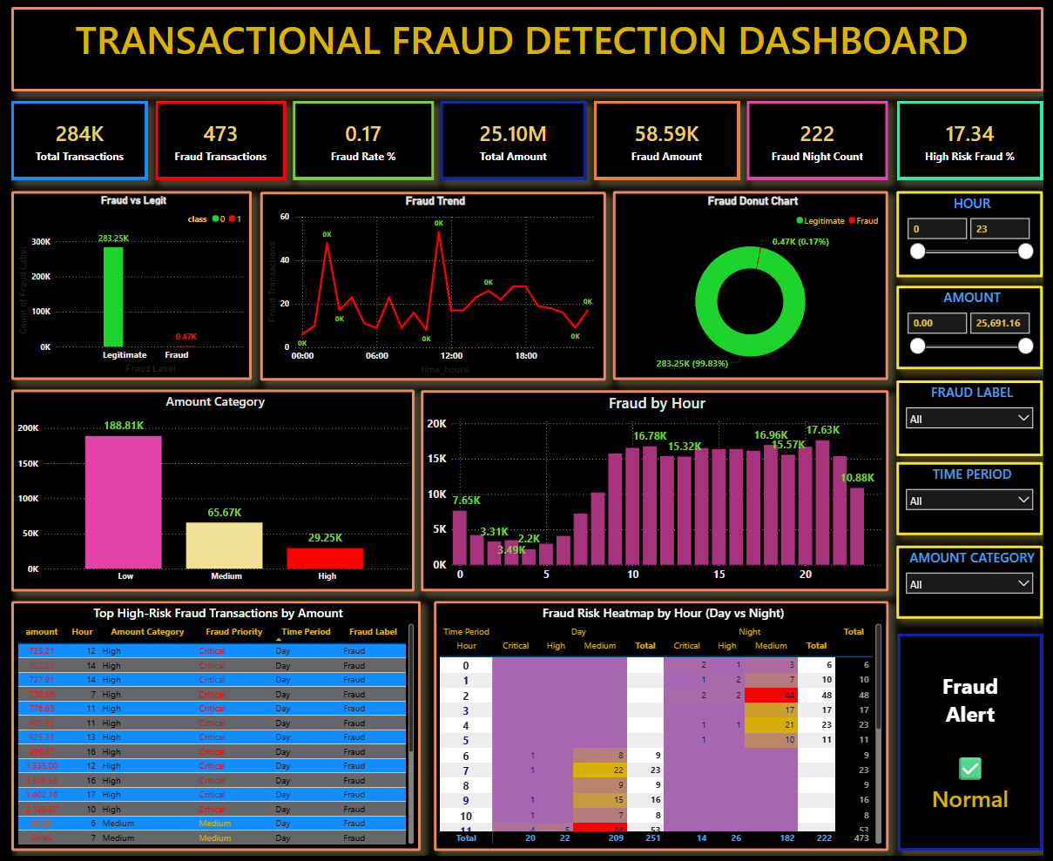
10.3 Business Insights Dashboard

Slide 14
11. Advantages
1. Real-time fraud detection
The system can instantly identify suspicious transactions as they occur, enabling quick action to prevent fraud.
2. Reduces financial losses
By detecting fraud early, the system helps minimize monetary damage caused by unauthorized transactions.
3. Improves customer trust
Accurate fraud detection ensures customer accounts are secure, increasing confidence in the system.
4. Supports business decision-making
Provides insights and analytics that help organizations understand fraud patterns and take informed actions.
5. Scalable and efficient system
The system is designed to handle large volumes of transaction data efficiently and can be expanded for real-world applications.

Slide 15
12. Conclusion
This project successfully demonstrates how machine learning and data analytics can be effectively utilized to detect fraudulent financial transactions. By analyzing historical transaction data and identifying hidden patterns, the system is capable of distinguishing between legitimate and fraudulent activities with high efficiency.
The integration of SQL for data processing, machine learning for prediction, and visualization tools for insights creates a comprehensive and practical solution. The system not only detects fraud but also provides meaningful business insights that can support strategic decision-making.
By incorporating techniques such as threshold tuning and probability-based prediction, the model is able to handle highly imbalanced datasets, which is one of the major challenges in fraud detection. Additionally, the deployment of a real-time Streamlit application ensures that predictions can be made instantly, making the system suitable for real-world usage.
The inclusion of interactive dashboards (Power BI) further enhances the usability of the system by allowing stakeholders to monitor fraud trends, identify high-risk patterns, and take proactive actions.
Overall, this project highlights the importance of combining data engineering, machine learning, and business intelligence to solve real-world problems.

Slide 16
13. References
● Kaggle Credit Card Fraud Detection Dataset: https://www.kaggle.com/datasets/mlg-ulb/creditcardfraud
● Pandas Documentation: https://pandas.pydata.org/docs/
● Seaborn Tutorial: https://seaborn.pydata.org/tutorial.html
● Scikit-learn Guide to Classification: https://scikit-learn.org/stable/supervised_learning.html#supervised-learning

Slide 17
THANKING YOU

